Slide 1

Bad SQL in het DIM (Topics DDL/DML)
Project DataFabriek
Februari 2024

Slide 2
Top 10 sql’s voor de 1e ronde !
WOW, welke tools en hoe gebruikt on insight te krijgen.
Sql developer DBA utility snapshot verwerken tot AWR rapport
Monitoring en logging (Datastage track) CTE’s
TIC daily prod
OEM performance en tuning pack indien available ! “Inrichting” staat op change lijst DXC !
CTE 1
CTE 2
CTE 3
CTE 4
CTE 5
Connection Pooling Datastage
Release / Delivery methologie
SGA uitbreiding Prod
PGA Uitbreiding Prod
Backup/Restore losing time
Monitoring en loggings CTE’s
Cost based statistics verversen
Informtie

Slide 3
Estafette parcour in het Data Integratie Magazijn
Bronontsluiting
Integratie
Informatieproducten

Slide 4
Levering en toegang van data
Bronnen
Bronontsluiting |  |  |  | Integratie |  |  |  | Informatieproducten
O | T | A | P | O | T | A | P | O | T | A | P
Ongemaskeerde data
Gemaskeerde data
SALT #1
SALT #2
SALT #3
SALT #4
SALT #5
SALT #2
SALT #3
SALT #4
SALT #5
SALT #2
SALT #3
SALT #4
SALT #5
P-regime | Alleen functie gebonden toegang of mbv Yellow Enveloppe Procedure
P-regime | Toegang voor Datafabriek en anderen tot gemaskeerde data
T-regime | Toegang voor Datafabriek en anderen
O-regime | Toegang voor Datafabriek en anderen
Maskeringsleutel

Slide 5
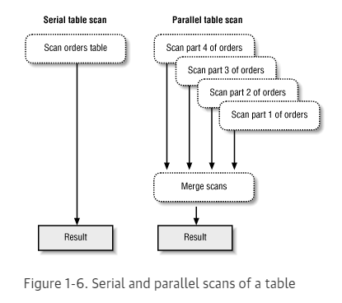
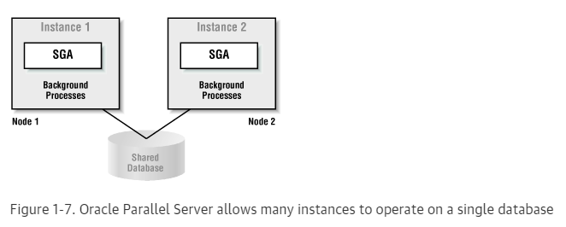
Show me

Slide 6
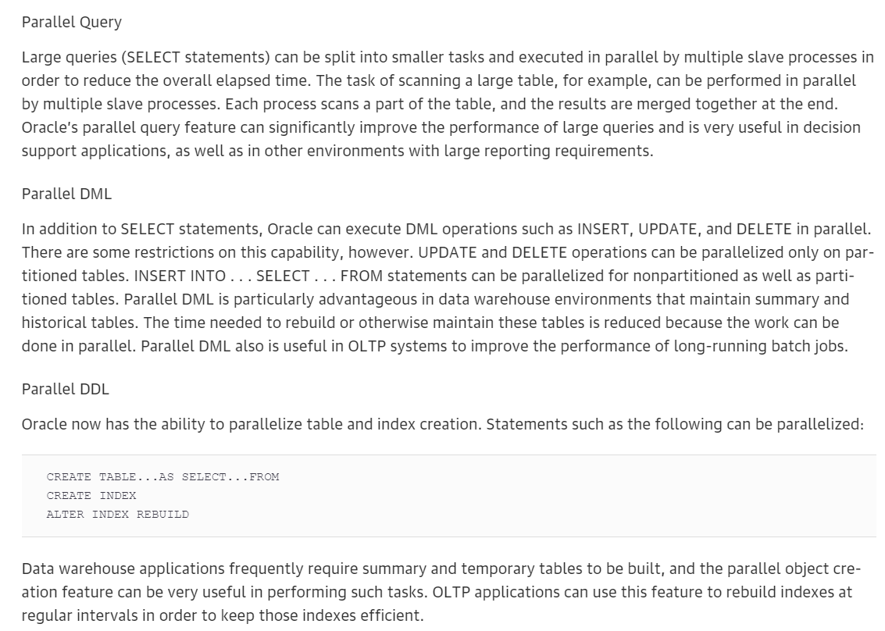
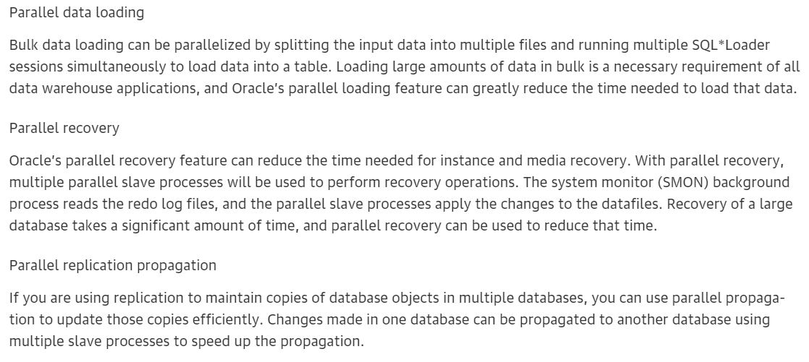

Slide 7
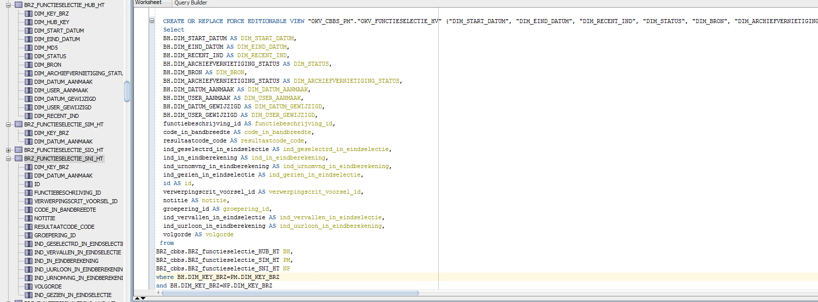

Slide 8
SQL_ID cuhb1t38xjvf0
Recommendation 2: SQL Tuning
Estimated benefit is .34 active sessions, 15.58% of total activity.
-------------------------------------------------------------------
Action
Run SQL Tuning Advisor on the INSERT statement with SQL_ID
"cuhb1t38xjvf0". Additionally, investigate this statement for possible
performance improvements. You can supplement the information given here
with an ASH report for this SQL_ID.
Related Object
SQL statement with SQL_ID cuhb1t38xjvf0.
INSERT INTO bdr_smz_sv_PM.bdr_smz_sv_herbo_ft(PCS_ID,DIM_DATUM_AANMAA
K,DIM_USER_AANMAAK,AFG_REGIE_EN_SMO_GELIJK,AFG_INDICATIE_VA,AFG_INDIC
ATIE_AD,DIM_SNAPSHOT_ID,DIM_ORGANISATIE_ID_ACTIEF……………………………………….)
VALUES(:PCS_ID,:DIM_DATUM_AANMAAK,:DIM_USER_AANMAAK,:AFG_RE
GIE_EN_SMO_GELIJK,:AFG_INDICATIE_VA,:AFG_INDICATIE_AD,:DIM_SNAPSHOT_I
D,:DIM_ORGANISATIE_ID_ACTIEF,:DIM_KLANT_ID,:DIM_UITSLAG_CLAIM_ID,:DIM
_LEEFTIJD_ID,:DIM_LEEFTIJD_ID_DATUM_AFGESLOTEN,:DIM_PROCESFASE_ID,:DI
M_PROCESDATA_ID,:DIM_PRODUCT_ID,:DIM_KLANTCATEGORIE_ID,:DIM_LAND_ID,:
DIM_ORGANISATIE_ID_REGIE,:DIM_ORGANISATIE_ID_SMO,:DIM_SOORT_AANVRAGER
_ID,:DIM_GESLACHT_ID,:S1600_NETTO_INPUT_MON,:S1601_OUTPUT_MON………………
‘………………………………………………………………………………………
UITING,:DOORLOOPTIJD_OEND,:DOORLOOPTIJD_INTAKE_REGIE,:DOORLOOPTIJD_IN
TAKE,:DOORLOOPTIJD_MED_BEOORDELING,:DOORLOOPTIJD_AD_BEOORDELING,:DOOR
LOOPTIJD_RDH,:INFO_UITSTEL_MED_INFO_AANTAL,:INFO_UITSTEL_MED_INFO_DUU
R,:INFO_UITSTEL_MED_EXP_AANTAL,:INFO_UITSTEL_MED_EXP_DUUR,:OUDERDOM_V
OORRAAD,:VOORPORTAAL_STREEFMAAND)
Rationale
The SQL spent 51% of its database time on CPU, I/O and Cluster waits.
This part of database time may be improved by the SQL Tuning Advisor.
Look at data given below and an ASH report for further performance
improvements.
Rationale
Database time for this SQL was divided as follows: 100% for SQL
execution, 0% for parsing, 0% for PL/SQL execution and 0% for Java
execution.
Rationale
SQL statement with SQL_ID "cuhb1t38xjvf0" was executed 1999 times and
had an average elapsed time of 0.65 seconds.
Rationale
Waiting for event "buffer busy waits" in wait class "Concurrency"
accounted for 39% of the database time spent in processing the SQL
statement with SQL_ID "cuhb1t38xjvf0".

Slide 9
Finding 1: Top SQL Statements
Impact is .54 active sessions, 29.04% of total activity.
--------------------------------------------------------
SQL statements consuming significant database time were found. These
statements offer a good opportunity for performance improvement.
Recommendation 1: SQL Tuning
Estimated benefit is .21 active sessions, 11.49% of total activity.
-------------------------------------------------------------------
Action
Investigate the TRUNCATE TABLE statement with SQL_ID "9afrk1sxxczuq" for
possible performance improvements. You can supplement the information
given here with an ASH report for this SQL_ID.
Related Object
SQL statement with SQL_ID 9afrk1sxxczuq.
Rationale
The SQL Tuning Advisor cannot operate on TRUNCATE TABLE statements.
Rationale
Database time for this SQL was divided as follows: 100% for SQL
execution, 0% for parsing, 0% for PL/SQL execution and 0% for Java
execution.
Rationale
Waiting for event "enq: RO - fast object reuse" in wait class
"Application" accounted for 45% of the database time spent in processing
the SQL statement with SQL_ID "9afrk1sxxczuq".
Rationale
Top level calls to execute the PL/SQL statement with SQL_ID
"63ccw3cq0tvrk" are responsible for 100% of the database time spent on
the TRUNCATE TABLE statement with SQL_ID "9afrk1sxxczuq".
Related Object
SQL statement with SQL_ID 63ccw3cq0tvrk.
begin
DBMS_MVIEW.REFRESH('BDR_SMZ_SV_PM.BDR_SMZ_SV_DO_AM', 'C', '', TRUE,
FALSE,0,0,0, FALSE, FALSE);
end;
Symptoms That Led to the Finding:
---------------------------------
Wait class "User I/O" was consuming significant database time.
Impact is .59 active sessions, 31.63% of total activity.
Finding 3: Checkpoints Due to DROP or TRUNCATE
Impact is .1 active sessions, 5.35% of total activity.
------------------------------------------------------
Buffer cache writes due to DROP and TRUNCATE operations had a significant
impact on the throughput of the I/O subsystem.
No recommendations are available.
Symptoms That Led to the Finding:
---------------------------------
Wait class "Application" was consuming significant database time.
Impact is .1 active sessions, 5.39% of total activity.

Slide 10
Impact is .05 active sessions, 2.73% of total activity.
-------------------------------------------------------
Read and write contention on database blocks was consuming significant
database time.
Recommendation 1: Schema Changes
Estimated benefit is .05 active sessions, 2.73% of total activity.
------------------------------------------------------------------
Action
Consider partitioning the INDEX "BDR_SMZ_SV_PM.BDR_SMZ_SV_DO_FKS_TB_PK"
with object ID 222861 in a manner that will evenly distribute concurrent
DML across multiple partitions.
Related Object
Database object with ID 222861.
Rationale
The INSERT statement with SQL_ID "7h6pj92zt1v7v" was significantly
affected by "buffer busy" waits.
Related Object
SQL statement with SQL_ID 7h6pj92zt1v7v.
INSERT INTO BDR_SMZ_SV_PM.BDR_SMZ_SV_DO_FKS_TB(DIM_KLANT_ID,DIM_UITSL
AG_CLAIM_ID,DIM_SNAPSHOT_ID,DIM_ORGANISATIE_ID_ACTIEF,DIM_ORGANISATIE
_ID_SMO,DIM_ORGANISATIE_ID_REGIE,DIM_PRODUCT_ID,DIM_PROCESFASE_ID,DIM
_SOORT_AANVRAGER_ID,PCS_ID,AFG_REGIE_EN_SMO_GELIJK,AFG_INDICATIE_VA,A
FG_INDICATIE_AD) VALUES(:DIM_KLANT_ID,:DIM_UITSLAG_CLAIM_ID,:DIM_SNAP
SHOT_ID,:DIM_ORGANISATIE_ID_ACTIEF,:DIM_ORGANISATIE_ID_SMO,:DIM_ORGAN
ISATIE_ID_REGIE,:DIM_PRODUCT_ID,:DIM_PROCESFASE_ID,:DIM_SOORT_AANVRAG
ER_ID,:PCS_ID,:AFG_REGIE_EN_SMO_GELIJK,:AFG_INDICATIE_VA,:AFG_INDICAT
IE_AD)
Symptoms That Led to the Finding:
---------------------------------
Read and write contention on database blocks was consuming significant
database time.
Impact is .05 active sessions, 2.73% of total activity.
Wait class "Concurrency" was consuming significant database time.
Impact is .07 active sessions, 3.69% of total activity

Slide 11
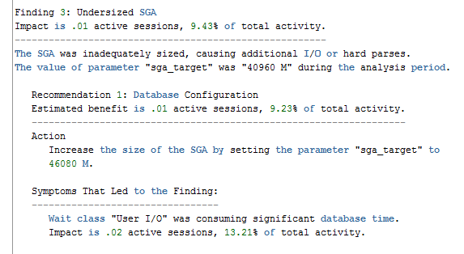
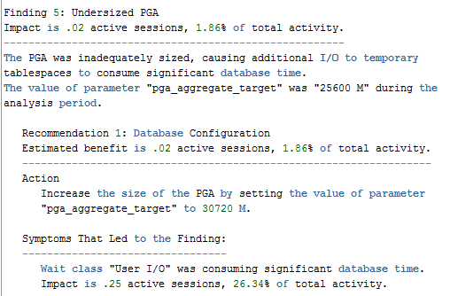

Slide 12
Finding 2: Top Segments by "User I/O" and "Cluster"
Impact is .4 active sessions, 18.17% of total activity.
-------------------------------------------------------
Individual database segments responsible for significant "User I/O" and
"Cluster" waits were found.
Recommendation 1: Segment Tuning
Estimated benefit is .15 active sessions, 6.72% of total activity.
------------------------------------------------------------------
Action
Run "Segment Advisor" on TABLE PARTITION
"INT_SMZ_SV_PM.INT_SMZ_SV_BEOORDELING_HT.PRT_DEFAULT" with object ID
111792.
Related Object
Database object with ID 111792.
Action
Investigate application logic involving I/O on TABLE PARTITION
"INT_SMZ_SV_PM.INT_SMZ_SV_BEOORDELING_HT.PRT_DEFAULT" with object ID
111792.
Related Object
Database object with ID 111792.
Rationale
The I/O usage statistics for the object are: 7426 full object scans,
35079526 physical reads, 0 physical writes and 35075173 direct reads.
Recommendation 2: Segment Tuning
Estimated benefit is .14 active sessions, 6.34% of total activity.
------------------------------------------------------------------
Action
Run "Segment Advisor" on TABLE PARTITION
"INT_SMZ_SV_PM.INT_SMZ_SV_BEOORDELING_HT.PRT_RECENT" with object ID
111791.
Related Object
Database object with ID 111791.
Action
Investigate application logic involving I/O on TABLE PARTITION
"INT_SMZ_SV_PM.INT_SMZ_SV_BEOORDELING_HT.PRT_RECENT" with object ID
111791.
Related Object
Database object with ID 111791.
Rationale
The I/O usage statistics for the object are: 5984 full object scans,
24773508 physical reads, 0 physical writes and 24775592 direct reads.
Symptoms That Led to the Finding:
---------------------------------
Wait class "User I/O" was consuming significant database time.
Impact is .49 active sessions, 22.72% of total activity
Recommendation 3: Segment Tuning
Estimated benefit is .06 active sessions, 2.65% of total activity.
------------------------------------------------------------------
Action
Run "Segment Advisor" on TABLE PARTITION
"INT_SMZ_SV_PM.INT_SMZ_SV_PROCESFASE_HT.PRT_RECENT" with object ID
208892.
Related Object
Database object with ID 208892.
Action
Investigate application logic involving I/O on TABLE PARTITION
"INT_SMZ_SV_PM.INT_SMZ_SV_PROCESFASE_HT.PRT_RECENT" with object ID
208892.
Related Object
Database object with ID 208892.
Rationale
The I/O usage statistics for the object are: 2394 full object scans,
11030471 physical reads, 0 physical writes and 11030294 direct reads.
Recommendation 4: Segment Tuning
Estimated benefit is .05 active sessions, 2.46% of total activity.
------------------------------------------------------------------
Action
Run "Segment Advisor" on TABLE PARTITION
"INT_SMZ_SV_PM.INT_SMZ_SV_PROCESFASE_HT.PRT_DEFAULT" with object ID
208893.
Related Object
Database object with ID 208893.
Action
Investigate application logic involving I/O on TABLE PARTITION
"INT_SMZ_SV_PM.INT_SMZ_SV_PROCESFASE_HT.PRT_DEFAULT" with object ID
208893.
Related Object
Database object with ID 208893.
Rationale
The I/O usage statistics for the object are: 2656 full object scans,
10637548 physical reads, 0 physical writes and 10636894 direct reads.

